Slide 1
DataMidWare A Data-Oriented Middleware & Application Integration
Jagriti Goswami

Slide 2
Outline
Motivation
Introduction of DataMidWare
Architectural Overview of the Software
Development Process Overview
Code Architecture Representation using Component View
Dependencies: Software, Tools, Libraries
Environment Installation
Code Implementation
Testing
Deployment & Execution – using PyCharm
Deployment & Execution – using Anaconda
Summary & Future Work

Slide 3
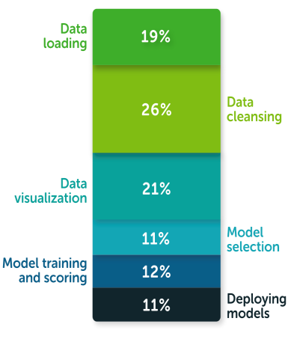
Motivation
In this data-driven-age, every small and large organization is taking their business decisions based on the data insights.
Transformation of raw data into usable cleaned data is crucial to take data-driven-decisions.
Data cleaning and preparation takes valuable time away from real data science work – model building and deployment
Bulk time is spent on data preparation (According to Anaconda survey-2020,
on average 45% of time is spent on data preparation, 21% of time spent on visualization)
Data preparation is challenging for multiple reasons :
Data from different sources come in various sizes and are different in nature.
Lack of integration between different data sources across the organization
Lack of proper integration between different technologies used for data science
Different platforms, software, libraries, and databases are used by developers
Managing dependencies and environments is another hurdle
Developing ad-hoc codes for specific use case
Why DataMiddleWare Python Library?
Accelerate data preparation, analysis, and visualization tasks under a unified and single framework to overcome efficiency gap
Why Python for Data Analysis? According to Anaconda’s survey, 47% of data scientists always use Python.
[The State of Data Science 2020]
DataMidWare is a data middleware which accelerates data preparation, analysis, and visualization tasks by integrating different technologies, software, and libraries using its APIs implemented in Python 3.

Slide 4
Introduction of DataMidWare
DataMidWare - A data middleware implemented in Python 3.7.
[https://github.com/JagritiG/data-middleware]
Provides direct interactions with database, data preparation & processing tool, algorithm library, and data visualization tool using its APIs.
Imports and parses raw data (csv, json, txt, xml) from different sources and load to database (MySQL, NoSQL).
Produces clean data from raw format and stores into database for analysis
Performs SQL queries using its APIs
Performs data analysis on the data stored in database
Provides direct visualization of data stored in database
Exports data in different format (csv, json) from database.
Accelerates data Preparation, Processing, and Visualization time

Slide 5












Architectural Overview
Application Layers
ETL
Query
Analytics
EDA
Models & Algorithms
Visualization
Python API Interface
Data Middleware
Data Processing Module - PyDp
Database Query Module - PyDb
Interface Module –
PyDm
Algorithms Module - PyAlgo
Data Visualization Module - PyViz
Database
File
Sources
Data Visualization
Static
Interactive
Dashboard
Web Visualization
MySQL
NoSQL
MSSQL

Slide 6
Development Process Overview
Requirements
Design
Implementation
Testing & Integration
Deployment
A Data Middleware that gives
flexibility to interact with databases, data process & analysis tools, algorithm library and visualization library
Create the architecture of the software system and its components
Implement the software
using Python 3
Implement Unit Test framework
In Python 3 and test the codes
Build Python package,
set up the environment and
run on Mac OS, Windows, & Linux system.

Slide 7
Code Architecture Representation using Component View
datamidware
__init__.py
pyalgo
pydb
pydm
pydp
pyviz
__init__.py
search.py
sort.py
__init__.py
create_connection.py
create_db.py
create_tb.py
mysql_query.py
__init__.py
file2db.py
db2file.py
db2viz.py
viz2db.py
db2algo.py
__init__.py
algorithm.py
__init__py
bar.py
setup.py
requirements.txt
LICENSE.txt
MANIFEST.in
README.md
tests
__init__.py
test_pydb.py
test_pydm.py
test_pydp.py
test_search.py
test_sort.py
test_mysql_query.py
settings

Slide 8
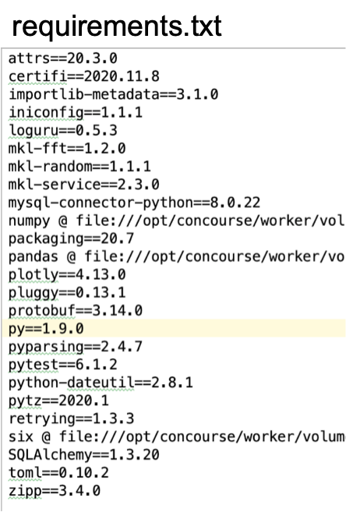
Dependencies: Software, Tools, Libraries
macOS Mojave (version 10.14.4)
IDE: PyCharm 18.3
Database Navigator (v3.2.1242.1)
MySQL Community Server 8.0.22
MySQL Workbench 6.3
Programming language: Python (version 3.7)
Python dependency packages – requirements.txt

Slide 9
Environment Installation
Environment/IDE Name | Download and Installation Link | Video Link
PyCharm 18.3 | https://www.jetbrains.com/help/pycharm/installation-guide.html PyCharm Setup guide: https://www.jetbrains.com/help/pycharm/getting-help.html
Mac OS Mojave (version 10.14.4) |  | https://www.youtube.com/watch?v=mDqxeCqVsOg
Windows |  | https://www.youtube.com/watch?v=EpjDOovzgrc
Linux |  | https://www.youtube.com/watch?v=hPhZOCXr_2w
MySQL Installation on Mac OS | MySQL installation using Homebrew - https://flaviocopes.com/mysql-how-to-install/ | https://www.youtube.com/watch?v=UcpHkYfWarM
MySQL Community Server 8.0.22 | Download Link , How to Install? | https://dev.mysql.com/doc/mysql-installation-excerpt/8.0/en/osx-installation-pkg.html
MySQL Workbench 8.0.21 | Download Link , How to Install? | MySQL workbench install using Homebrew - https://gist.github.com/jonjack/37ce2d0a28fc53d85d7c18de8065d555
MySQL Installation on Windows |  | https://www.youtube.com/watch?v=WuBcTJnIuzo
MySQL Community Server 8.0 | Download Link , How to Install?
MySQL Community Server 8.0.22 | Download Link
MySQL Installation on Linux
MySQL Community Server 8.0.22 | Download Link , How to install? | https://www.youtube.com/watch?v=3qD6zv7thdE
MySQL Workbench 8.0.21 | Download Link , How to install? | https://www.youtube.com/watch?v=9aYLRfp5870

Slide 10
Code Implementation
API | Description | Parameters | Imports statement | Example Link
file2db.file2db(host, user, password, filename, db_name, tb_name, file_type="file_type", db_type="db_type") | Imports raw structured/semi-structured data (csv, json) into database (MySQL, NoSQL) | host: host name user: user name password: password filename: filename to send to database file_type: file type (csv, json), str db_type: database type (mysql, nosql), str tb_name: table name where data will be stored | from datamidware.pydm import file2db | Example, Doc
db2file.db2file(host, user, password, file_path, db_name, tb_name, file_type="file_type", db_type="db_type") | Exports table data as csv/json format from the database | host: host name user: user name password: password file_path: file path to export data from database file_type: file type (csv, json) db_type: database type (mysql, nosql) db_name: database from where data is exported tb_name: table from where data will be exported | from datamidware.pydm import db2file | Example, Doc
create_mysql_db.create_mysql_db(host, user, password, db_name) | Creates a new MySQL database | host: host name user: user name password: password db_name: database name to be created | from datamidware.pydm import create_mysql_db
mysql_query.MySQLDatabase.select(tb_name, row_count="all") | Execute SQL query: SELECT * FROM table. Selecting all(or one if row_count="one") rows from the table. | query: SQL query to select rows: SELECT * FROM <table> row_count: "all" or "one" row. default "all". return: list of rows selected. | from datamidware.pydm import mysql_query | Example, Doc

Slide 11
Code Implementation
API | Description | Parameters | Imports statement | Example Link
csv2mysql.csv2mysql(host, user, password, filename, db_name, tb_name) | Imports csv file into mysql database | host: host name user: user name password: password filename: filename to send to database db_name: name of the database -- if database already exists, import data in the existing database, if not exists, create new database and import data. tb_name: name of the table - if table already exists, add data in the existing table, if not exists, create new table and import data. | from datamidware.pydm import csv2mysql | Doc
mysql2csv.mysql2csv(host, user, password, file_path, db_name, tb_name) | Exports csv file from mysql database table | host: host name user: user name password: password file_path: file path to save csv file db_name: name of the database from where data will be exported tb_name: name of the table from where data will be exported | from datamidware.pydm import mysql2csv | Doc
db2viz.db2viz(host, user, password, db_name, tb_name, kind=None, x=None, y=None, …) | Visualize the Database table data | host: host name, user: user name password: password, db_name: database name tb_name: table name, kind: plot kind (bar, horizontal bar, hist,..), file_path: file path to save figure x: x data; list or array-like, y: y data; list or array-like title: title of the figure, label: x-label, y-label | from datamidware.pydm import db2viz | Example, Doc

Slide 12
Testing
Modules | Description | Execution command | Remark
test_connect2mysql | Test module for DB connection check | pytest tests/test_connect2mysql | Pass
test_pydm.py | Test module for pydm sub-package | pytest tests/test_pydm.py | Pass
test_mysql_query.py | Test module for mysql_query.py module | pytest tests/test_mysql_query.py | Pass
test_pyviz.py | Test module for visualization library | pytest tests/test_pyviz.py | Pass
test_search.py | Test module for search.py module | python3 -m unittest tests/test_search.py | Pass
test_sort.py | Test module for sort.py module | python3 -m unittest tests/test_sort.py | Pass

Slide 13
Deployment & Execution – using PyCharm
PyCharm Installation and setup -
Install MySQL server 8.0.22 (using Homebrew on Mac Mojave >= 10.14.4)
Install MySQL Workbench 8.0.21 (using Homebrew on Mac Mojave >= 10.14.4)
Create new project in virtual environment in PyCharm -
Clone package from Github –
Install Database Navigator -
To install dependencies, install requirements.txt using pip -

Slide 14
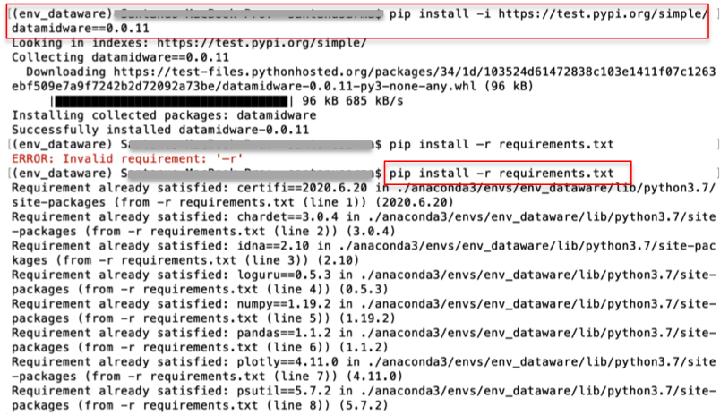
Deployment & Execution – using Anaconda
Anaconda installation and setup [ https://docs.anaconda.com/anaconda/install/mac-os/ ]
Using the terminal or an Anaconda Prompt, create a new environment – $ conda create –n env_name python=3.7
Activate new environment using - $ conda activate env_name
Install package using pip – $ pip install -i https://test.pypi.org/simple/ datamidware==2020.12.dev1
Or clone from Github – open terminal and type - $ git clone https://github.com/JagritiG/data-middleware.git
Install requirements.txt using pip - $ pip install –r requirements.txt

Slide 15
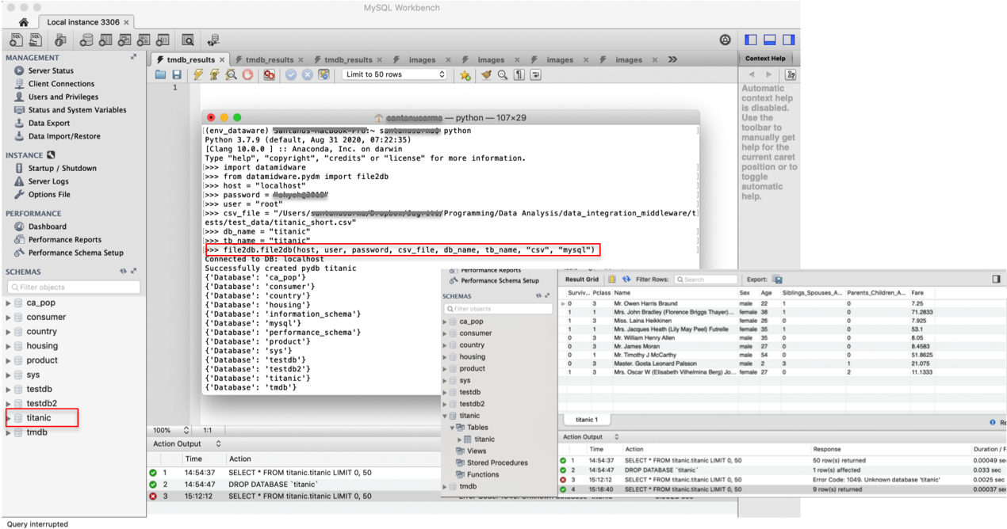
Example:file2db.file2db(host, user, password, filename, db_name, tb_name, file_type="file_type", db_type="db_type")
Execute file2db.file2db(host, user, password, filename, db_name, tb_name, file_type="file_type", db_type="db_type") to load csv file into MySQL DB
Example data: titanic.csv
Back

Slide 16
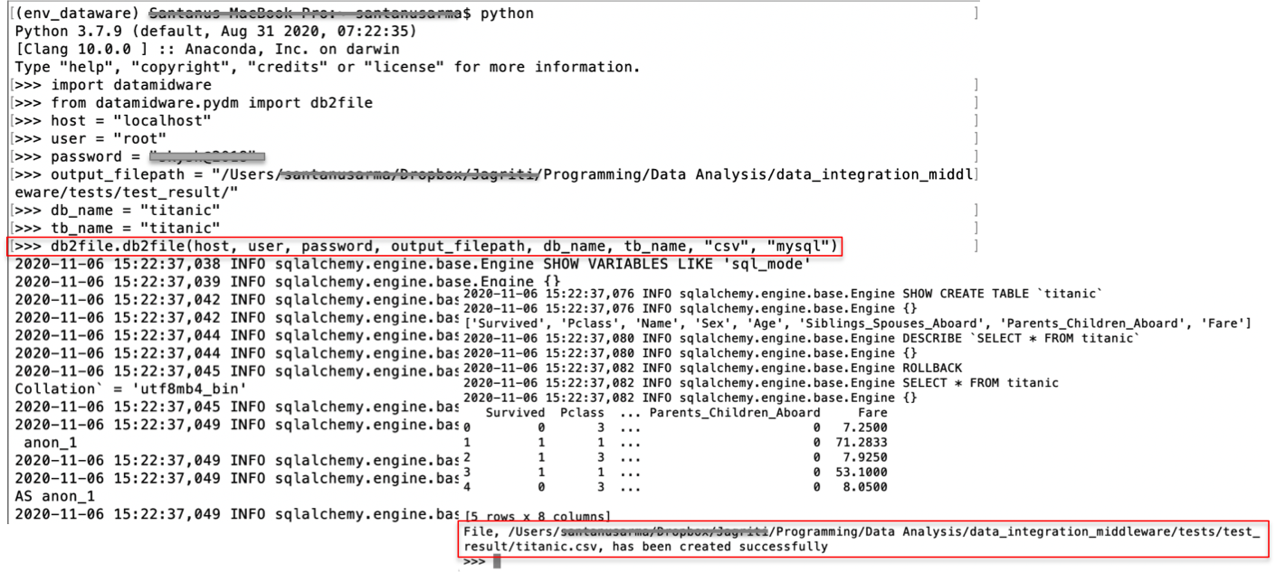
Example:db2file.db2file(host, user, password, file_path, db_name, tb_name, file_type="file_type", db_type="db_type”)
Execute db2file.db2file(host, user, password, file_path, db_name, tb_name, file_type="file_type", db_type="db_type”) to export csv file from MySQL
Example data: MySQL database name : titanic, table name = titanic
Back

Slide 17
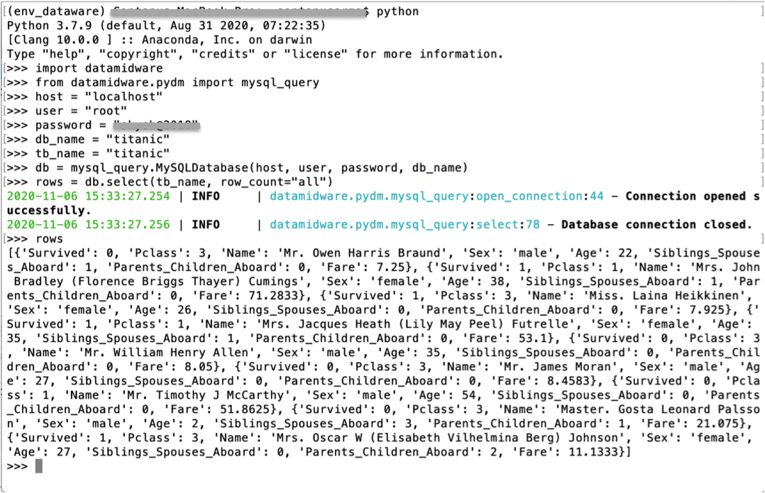
Example: mysql_query.MySQLDatabase.select(tb_name, row_count="all”)
Execute mysql_query.MySQLDatabase.select(tb_name, row_count="all”) to select all rows from MySQL table
Example data: MySQL database name : titanic, table name = titanic
Back

Slide 18
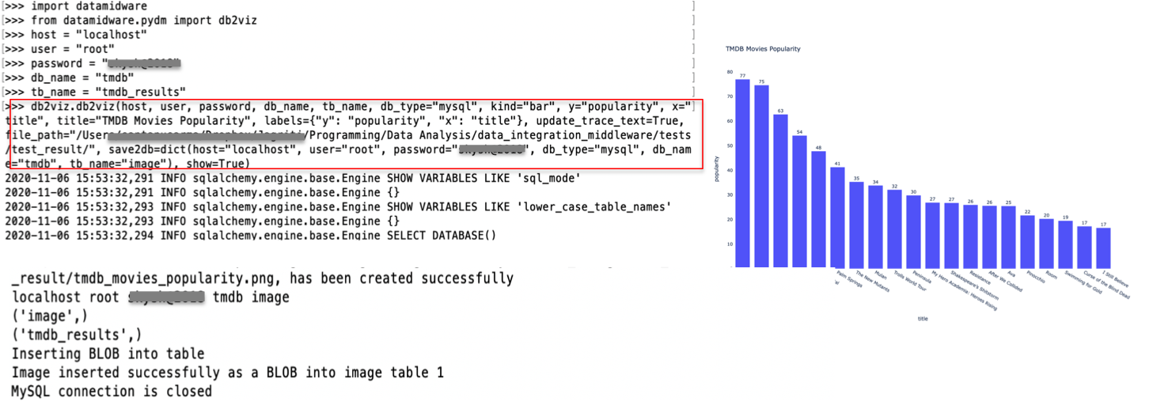
Example: db2viz.db2viz(host, user, password, db_name, tb_name, kind=None, x=None, y=None, …)
Execute db2viz.db2viz(host, user, password, db_name, tb_name, kind=None, x=None, y=None, …) to plot bar chart to visualize movies by popularity from tmdb_results table from MySQL database tmdb.
Example data: database name - tmdb, table name - tmdb_results
Back

Slide 19
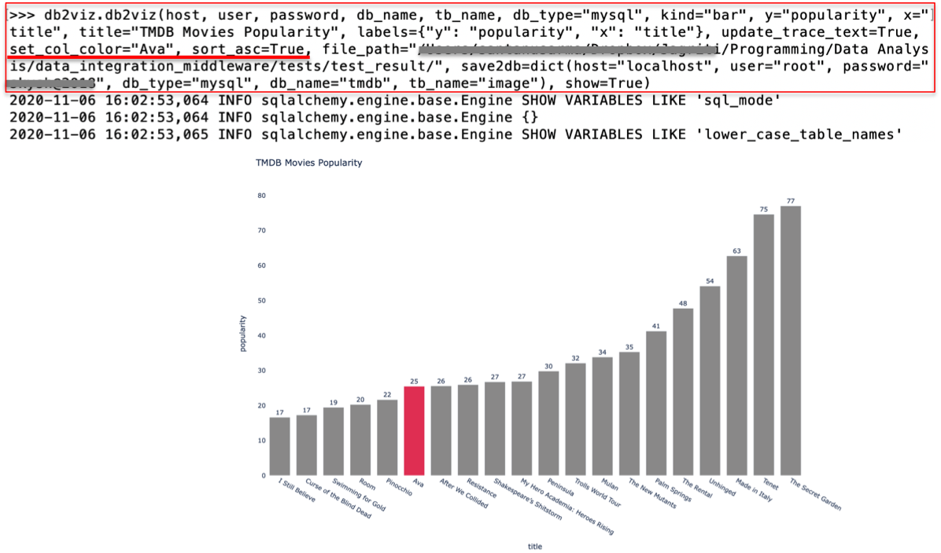
Example: db2viz.db2viz(host, user, password, db_name, tb_name, kind=None, x=None, y=None, …)
Execute db2viz.db2viz(host, user, password, db_name, tb_name, kind=None, x=None, y=None, …) to plot bar chart for movies by popularity from tmdb_results table in ascending order and highlighting movie title - “Ava”
Back

Slide 20
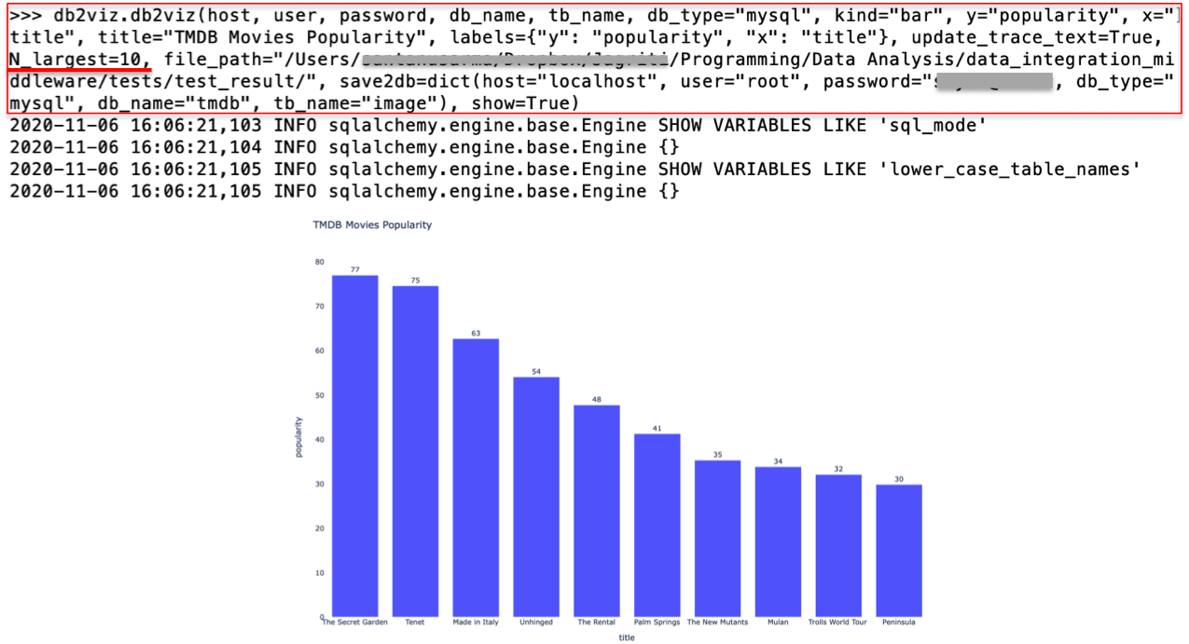
Example: db2viz.db2viz(host, user, password, db_name, tb_name, kind=None, x=None, y=None, …)
Execute db2viz.db2viz(host, user, password, db_name, tb_name, kind=None, x=None, y=None, …) to plot bar chart for 10 highest movies by popularity from tmdb_results table of tmdb database.
Back

Slide 21
Summary & Future Work
Summary
A data middleware that gives flexibility to directly interact with database, data preparation & processing tool, algorithm library, and data visualization tool using its APIs; accelerates data preparation, processing, & Visualization time
Imports and parses raw data (csv, json, txt, xml) and load to database (MySQL, NoSQL).
Produces clean data from raw format and stores into database for analysis
Performs SQL queries
Provides data analysis and direct visualization of data stored in database
Exports data in different format (csv, json) from database.
Future Work
Extend all the libraries – (data processing, algorithms, and data visualization library)
Integrate Exploratory and Inferential data analysis library
Integrate Machine Learning algorithms library
Integrate Web Visualization
Integrate with other Databases (MSSQL)
Integrate with Splunk

Slide 22
MySQL Installation on Mac OS X
MySQL Community Server 8.0.21 Download (MacOS Mojave version 10.14.4):
Open the below link on https://www.mysql.com/downloads/ and Click on – MySQL Community (GPL) Downloads
Or directly open the below link to download MySQL community version https://dev.mysql.com/downloads/
Using step-1 or step-2 navigate to MySQL Community Downloads page (fig-1) and Open MySQL Community Server (fig-2)
Select operating system from dropdown menu - macOS
To download latest version (8.0.22) - macOS 10.15 (x86, 64-bit), DMG Archive (mysql-8.0.22-macos10.15-x86_64.dmg ), click on <download>
To download version 8.0.21 click on Archives
To download macOS 10.15 (x86, 64-bit), DMG Archive (mysql-8.0.21-macos10.15-x86_64.dmg ), click on download
Login Now or Sign Up window (fig-3) will appear – (No need to click on Login or Sign Up)
Click on -> No Thanks, just start my download.
Back

Slide 23
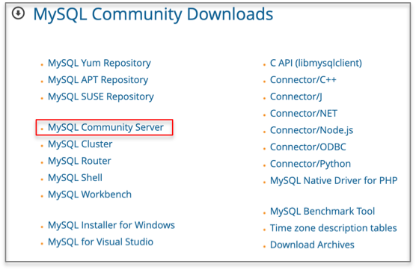
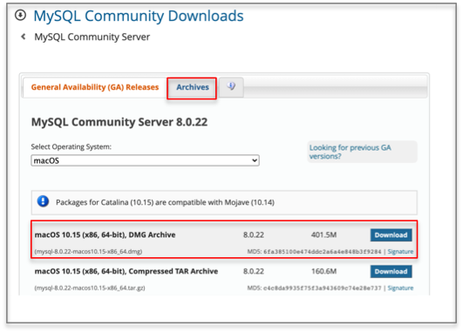
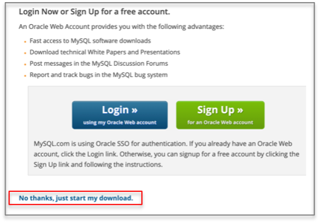
MySQL Installation on Mac OS X
Fig-1
Fig-2
Fig-3
Back

Slide 24
MySQL Installation on Mac OS X
Installation and Setup:
Double click on .dmg file (mysql-8.0.21-macos10.15-x86_64.pkg file will appear)(fig-4) (if latest version is downloaded, then file name will be different)
To start installing double click on -> mysql-8.0.21-macos10.15-x86_64.pkg
Install window will appear (fig-5) -> click on <Continue>
Agree the License agreement and click <Continue>
Change destination if you want or keep it as default and click on <Continue>
In the installation window, give Mac OS password and click on <Install Software>
Now Installation starts
After installation is done, a temporary password will be generated (fig-6)
Copy and save this password. It is required to build database connection for the first time.
Close all the windows and check whether MySQL is installed correctly on Mac OS or not
To check correctly installed or not, click on Apple icon on left upper corner -> go to System Preferences
Check for MySQL Logo (fig-7)- if present, that means MySQL is installed correctly.
Click on MySQL Logo -> MySQL Server Status window appears (fig-8) -> click on <Start MySQL Server>
MySQL Server is now running
Back

Slide 25
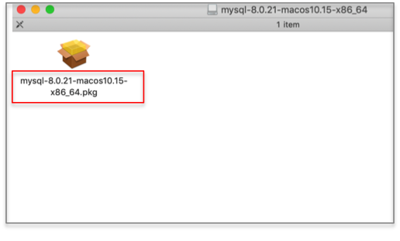
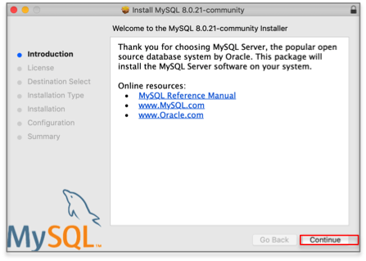
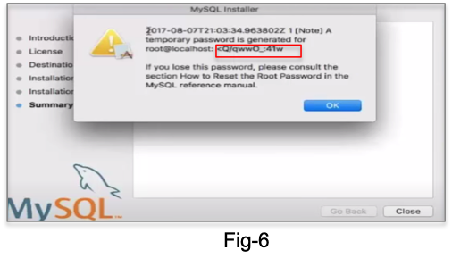
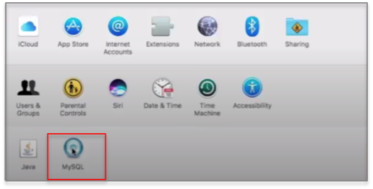
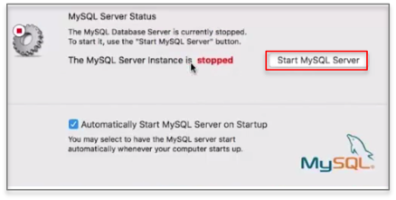
MySQL Installation on Mac OS X
Fig-4
Fig-5
Fig-6
Fig-7
Fig-8
Back

Slide 26
MySQL Installation on Mac OS X
Connect to the MySQL Server using MySQL Client
To connect to the server using Terminal, follow the below steps:
Set MySQL location in .bash_profile
Open Terminal, make sure you are in home directory, to confirm this type command – pwd. Then type command – ls –all
Open .bash_profile using command – open –t .bash_profile
If .bash_profile is not present, create one using command – touch .bash_profile and open it
Copy export PATH=${PATH}:/usr/local/mysql/bin/ to .bash_profile. Save this and close the file
Connect to the MySQL server using terminal – open terminal and type command mysql –u root –p (connects to the MySQL server using root user and –p flag, the saved temporary password)
Give the temporary password saved during installation and press <Enter> → MySQL terminal will open (fig-9)
First change temporary password using command ALTER USER ‘root’@’localhost’ IDENTIFIED BY ‘newpassword’ (fig-10)
Open a new terminal and again type command mysql –u root –p and give new password to open MySQL terminal
Now type SQL statement <show databases;> to see default databases (fig-11). See MySQL tutorial https://www.w3schools.com/sql/ for more
Back

Slide 27
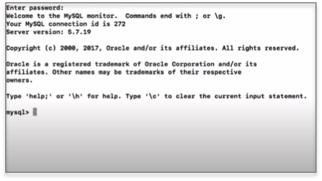
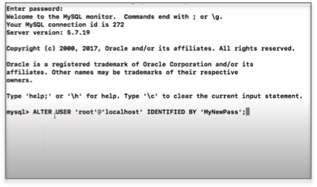
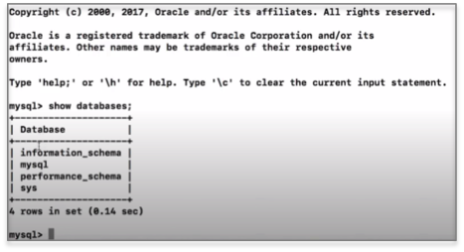
MySQL Installation on Mac OS X
Fig-9
Fig-10
Fig-11
Back

Slide 28
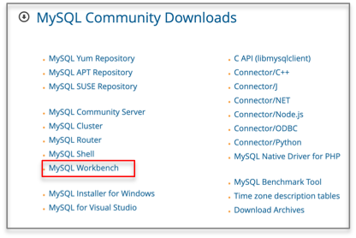
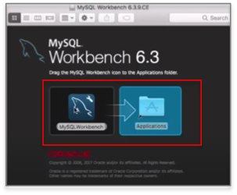
MySQL Installation on Mac OS X
To connect to server using MySQL Workbench, follow the below installation and setup steps
Go to MySQL Community Downloads page https://dev.mysql.com/downloads/ and click on MySQL Workbench (fig-12)
Download MySQL Workbench in the similar way as MySQL Community Serve
Open MySQL Workbench dmg file (fig-13) and drag & drop MySQL Workbench into Application folder
Open MySQL Workbench from Launch Pad or Application folder – (fig-14)
By default MySQL server starts on port 3306, click on this and give newpassword reset from terminal and check <Save password in keychain>box(fig-14) → click ok to open MySQL interface (fig-15)
Fig-12
Fig-13
Back

Slide 29
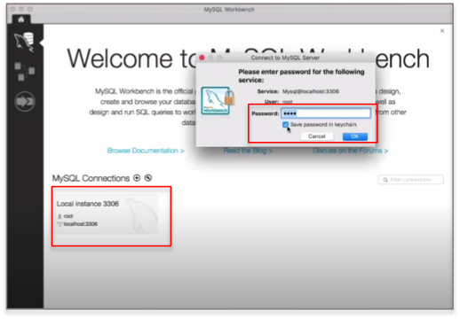
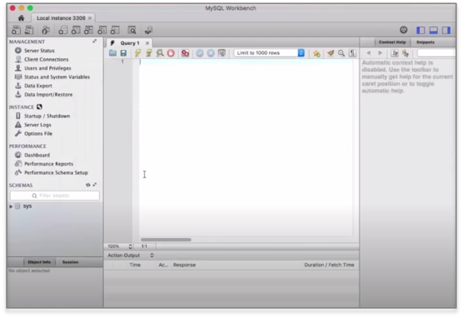
MySQL Installation on Mac OS X
Fig-14
Fig-15
Back

Slide 30
MySQL Installation on Windows
MySQL Community Server Download:
Open the given link to download MySQL community version https://dev.mysql.com/downloads/
Click on MySQL Community Server
Select operating system from dropdown menu – Microsoft Windows (fig-16)
Click on <Go to Download Page> tab next to Windows (x86, 32 & 64-bit), MySQL Installer MSI (fig-16)
Download (mysql-installer-community-8.0.22.0.msi) (fig-17)
To install version 8.0.21, click on Archives → download (mysql-installer-community-8.0.21.0.msi)
Login Now or Sign Up window (fig-18) will appear – (No need to click on Login or Sign Up)
Click on -> No Thanks, just start my download.
Back

Slide 31
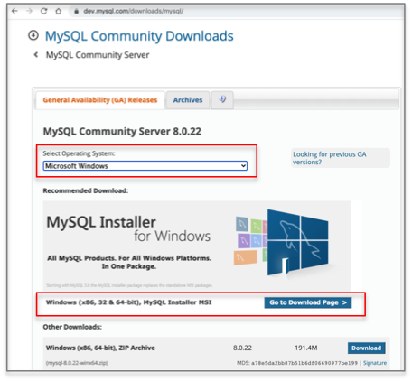
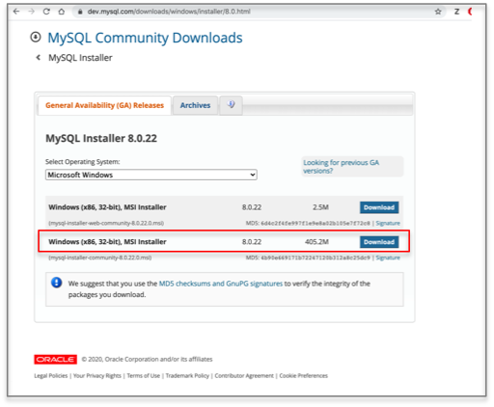
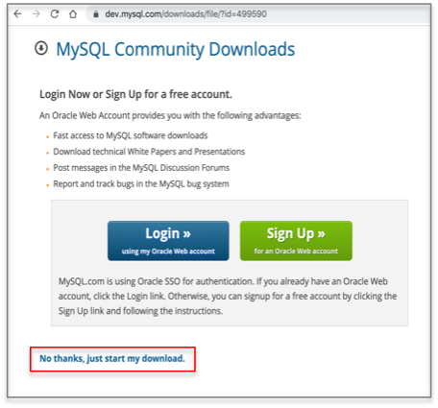
MySQL Installation on Windows
Fig-16
Fig-17
Fig-18
Back

Slide 32
MySQL Installation on Windows
Installation and Setup: Follow the steps shown in the video -> https://www.youtube.com/watch?v=WuBcTJnIuzo
Open the downloaded msi file
To start installing double click on the msi file
User Account Control warning may appear, read carefully and click yes to continue
MySQL Installer wizard will appear (fig-19)
Agree the License agreement and click <Next>
On <Choosing a Setup Type> select <Developer Default> click <Next> (fig-20) (warning may appear, read carefully and click yes to continue)
On <Installation> wizard click <Execute> to start installing products one by on one → click <Next>
On <Product Configuration> click <Next>
On <Type and Networking> wizard select <Standalone MySQL Server/Classic MySQL Replication> and click <Next>
For server configuration type, select <Development machine> and click <Next> (fig-21)
On <Accounts and Roles> wizard give MySQL root password and store it in a secure place (fig-22). You can also set user account. <Next>
On <Windows Service> wizard, click <Next> with default settings
On <Plugins and Extensions> wizard, click <Next> with default settings
On <Apply Configuration> wizard, click <Execute> -> click <Finish> → <Product Configuration> wizard will appear again
Click <Next> for MySQL Router Configuration --> click <Finish> → <Product Configuration> wizard will appear again
Click <Next> for Samples and Examples--> <Connect to Server> wizard will appear. Select the server and Check it (fig-23) → click <Next>
On <Apply Configuration> wizard, click <Execute> -> click <Finish> → <Product Configuration> wizard will appear again → click <Next>
<Installation Complete> wizard will appear → click <Finish>
MySQL Workbench and MySQL Shell will appear
Back

Slide 33
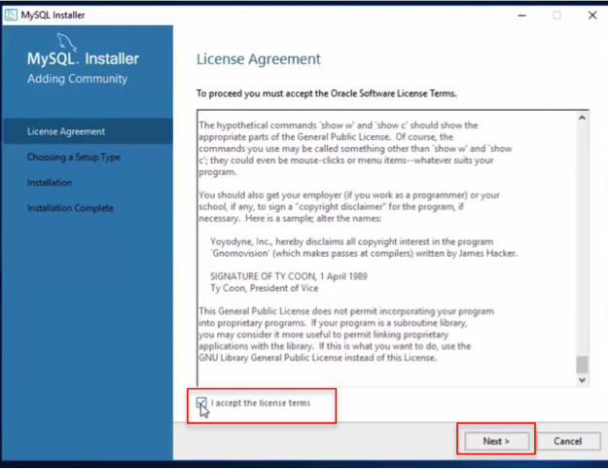
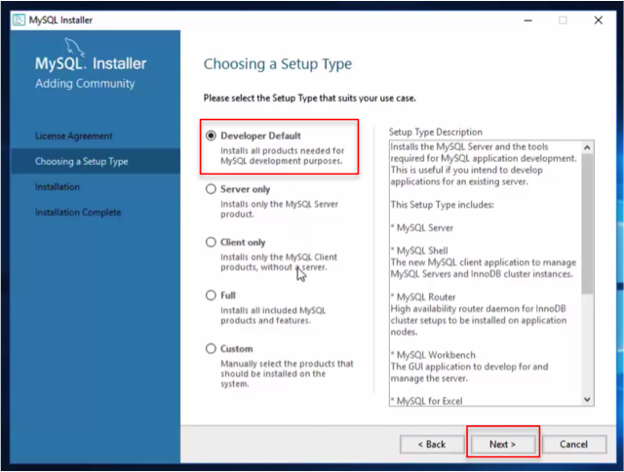
MySQL Installation on Windows
Fig-19
Fig-20
Back

Slide 34
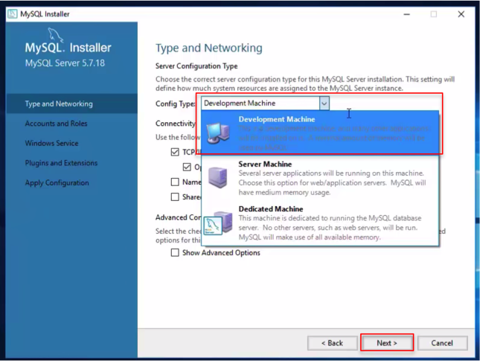
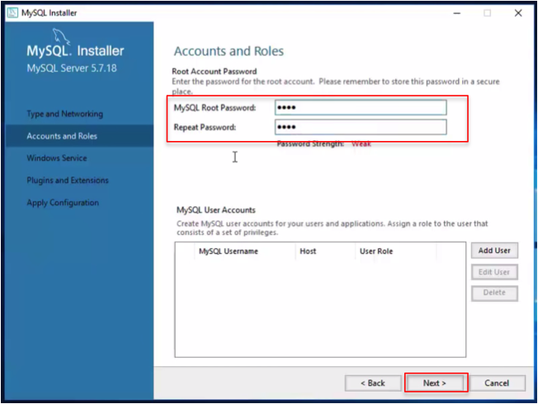
MySQL Installation on Windows
Fig-21
Fig-22
Back

Slide 35
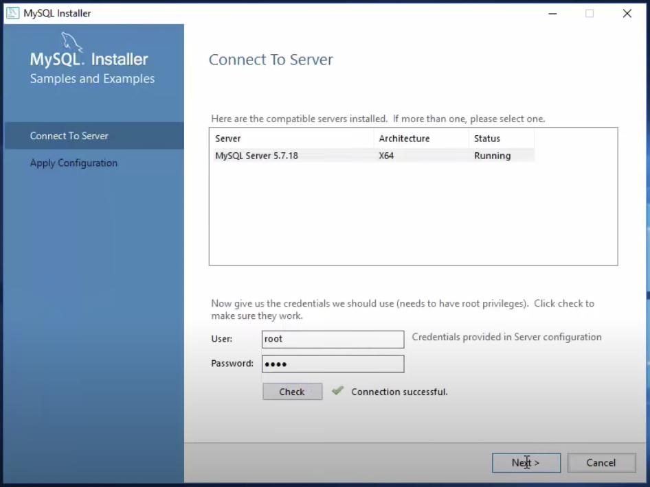
MySQL Installation on Windows
Fig-23
Back

Slide 36
MySQL Installation on Windows
Connect to the MySQL Server using MySQL Client
Using MySQL Command Line
Go to <Start> menu → go to <All apps> → Expand <MySQL> → open <MySQL Command Line Client>
Give root password
Now it’s set to interact with the databases
Write SQL command <show databases;> to see the databases present in the MySQL Server (fig-24)
See MySQL tutorial https://www.w3schools.com/sql/ for more SQL statements
Using GUI - MySQL Workbench
Go to <Start> menu → go to <All apps> → Expand <MySQL> → open <MySQL Workbench>
Go to <Database> tab → select <Connect to database> (fig-25)
Select <Local Instance MySQL Router> in Stored Connection
Give root password and click <Ok> (fig-26)
Click <Ok> to connect to the MySQL Server
MySQL Workbench interface will appear (fig-27)
Back

Slide 37
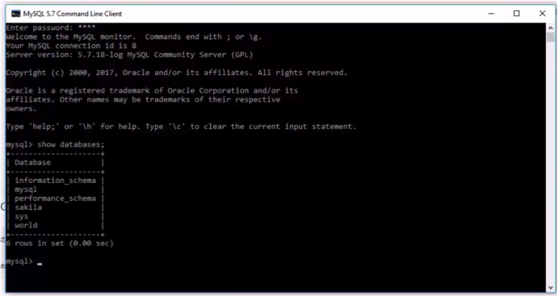
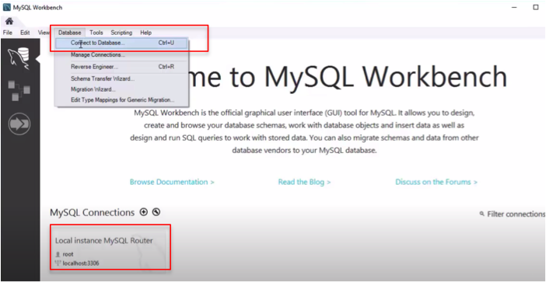
MySQL Installation on Windows
Fig-24
Fig-24
Back

Slide 38
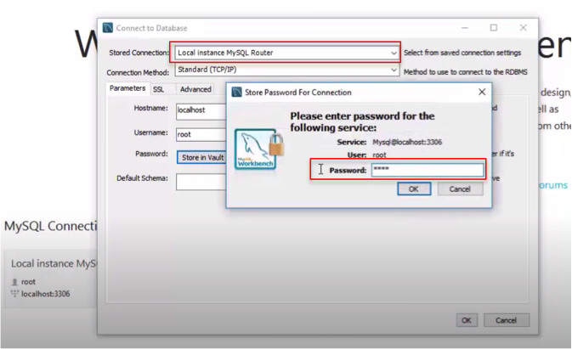
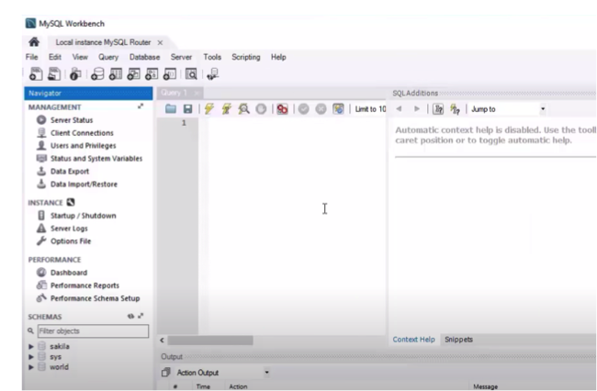
MySQL Installation on Windows
Fig-26
Fig-27
Back

Slide 39
MySQL Installation on Linux
MySQL Community Server Installation:
Follow the installation steps show in video - https://www.youtube.com/watch?v=3qD6zv7thdE
Open up terminal and update repository using command - $ sudo apt update
Once updated is done, Upgrade repository using command - $ sudo apt upgrade
Install MySQL Server using command - $ sudo apt install mysql-server
Check whether it is installed or not using command – $ mysql – version
Set root password using command - $ sudo mysql_secure_installation
Press y to setup VALIDATE PASSWORD component
3 levels of password validation policy
Enter 0 for low, 1 for medium, and 2 for strong password
Now enter new password
It will ask to continue with password provided – press y to continue
It will ask to remove anonymous users – press y to remove
Disallow root login remotely? – press y to disallow
Remove test database and access to it? – press y to remove privileges on the databases
Reload privilege tables now? – press y
Go to mysql console and type command - $ sudo mysql –u root
Now MySQL interface will appear
To check – type SQL statement <show databases;>
See MySQL tutorial https://www.w3schools.com/sql/ for more SQL statements
Back

Slide 40
MySQL Installation on Linux
To connect to server using MySQL Workbench, follow the below installation and setup steps
Follow the installation steps show in video - https://www.youtube.com/watch?v=9aYLRfp5870
Go to MySQL Community Downloads page https://dev.mysql.com/downloads/ and click on MySQL Workbench (fig-28)
Select operating system from dropdown menu – Ubuntu Linux (fig-29)
Click on <Download> – (fig-29)
Login Now or Sign Up window (fig-30) will appear – (No need to click on Login or Sign Up)
Click on -> No Thanks, just start my download.
Open downloaded file –> click on <Install> (fig-31)
Give system password for authentication – starts installing
Open MySQL Workbench
By default MySQL server starts on port 3306, click on this or add sign (+) – (fig-32)
Give root password set from terminal and check <Save password in keychain> box(fig-32)
Click <Ok> to open MySQL interface (fig-33)
Back

Slide 41
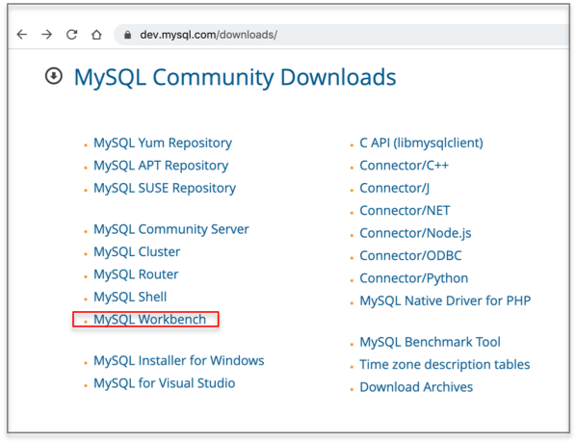
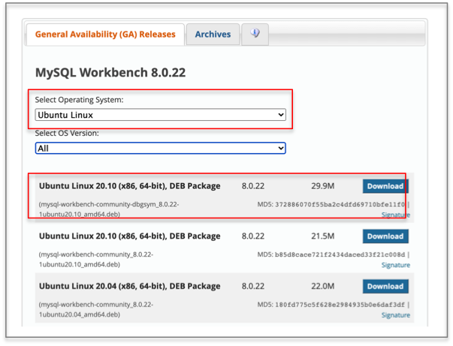
MySQL Installation on Linux
Fig-28
Fig-29
Back

Slide 42
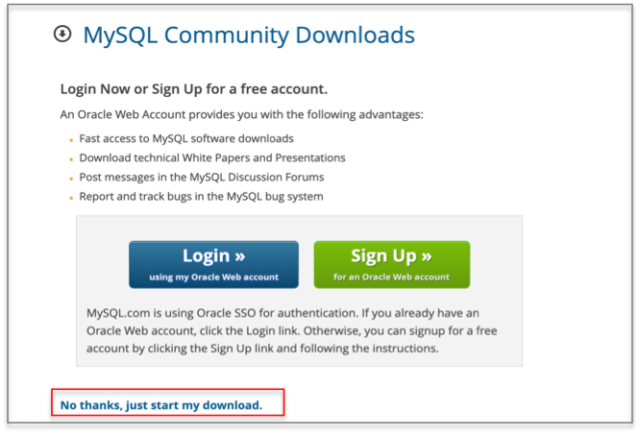
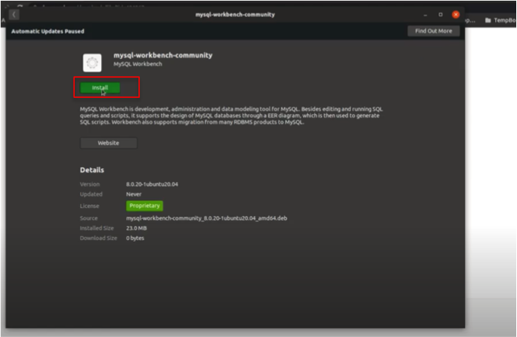
MySQL Installation on Linux
Fig-30
Fig-31
Back

Slide 43
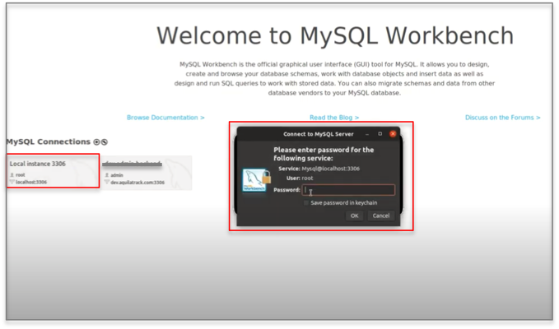
MySQL Installation on Linux
Fig-32
Fig-33
Back

